Slide 1
0x401 – Reverse Engineering
ECED4406 – Computer Security
Dr. Colin O’Flynn
Dalhousie University.

Slide 2
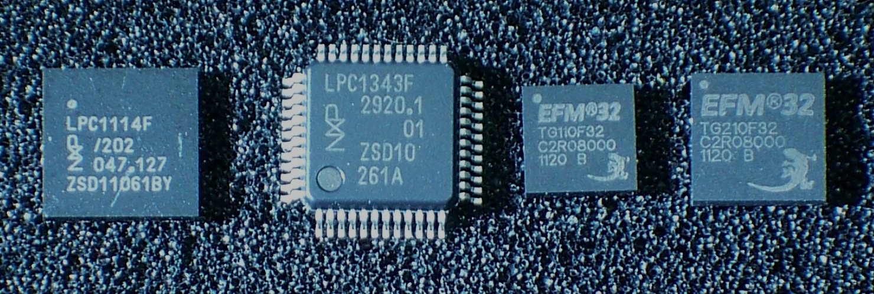
Software Reverse Engineering
Software reverse engineering is common requirement as part of security research.
We will focus in particular on Arm Cortex-m language reverse engineering.
https://en.wikipedia.org/wiki/ARM_Cortex-M#/media/File:ARM_Cortex-M0_and_M3_ICs_in_SMD_Packages.jpg

Slide 3
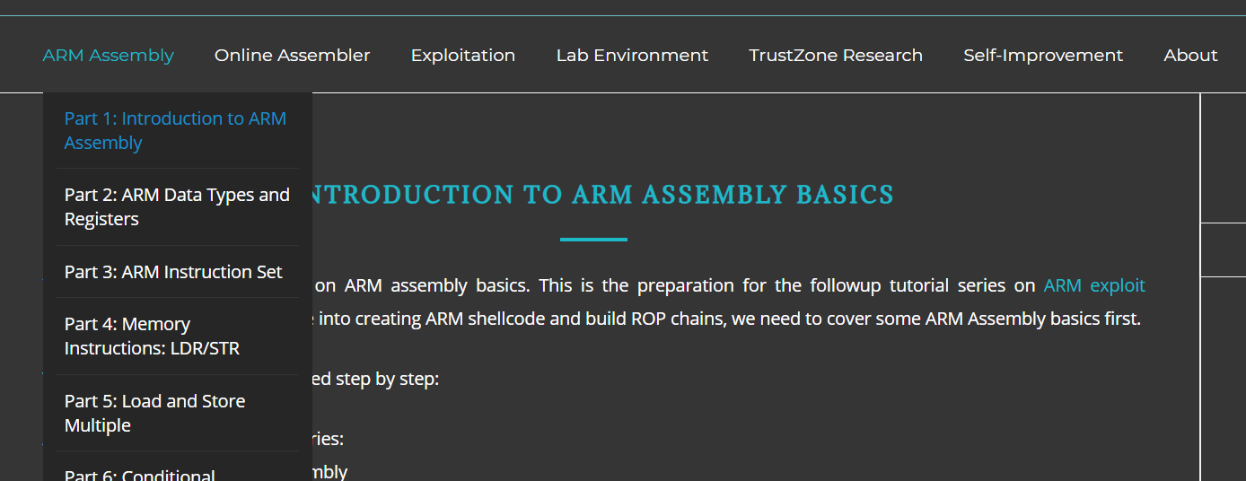
Resources for Arm Reverse Engineering
Recommended resource for more in depth - Azeria Labs -
https://azeria-labs.com/writing-arm-assembly-part-1/

Slide 4
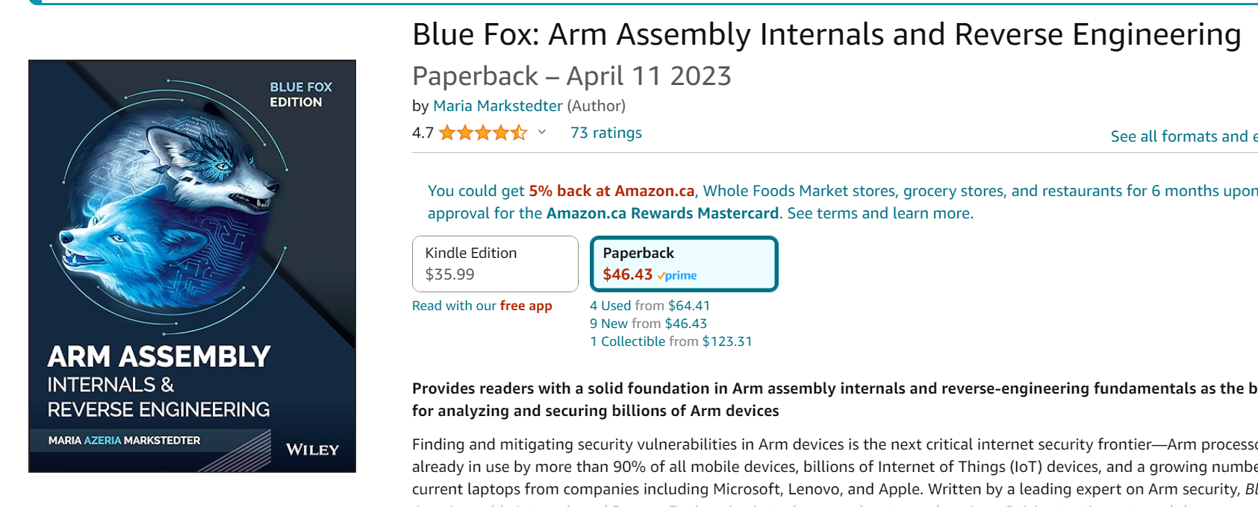
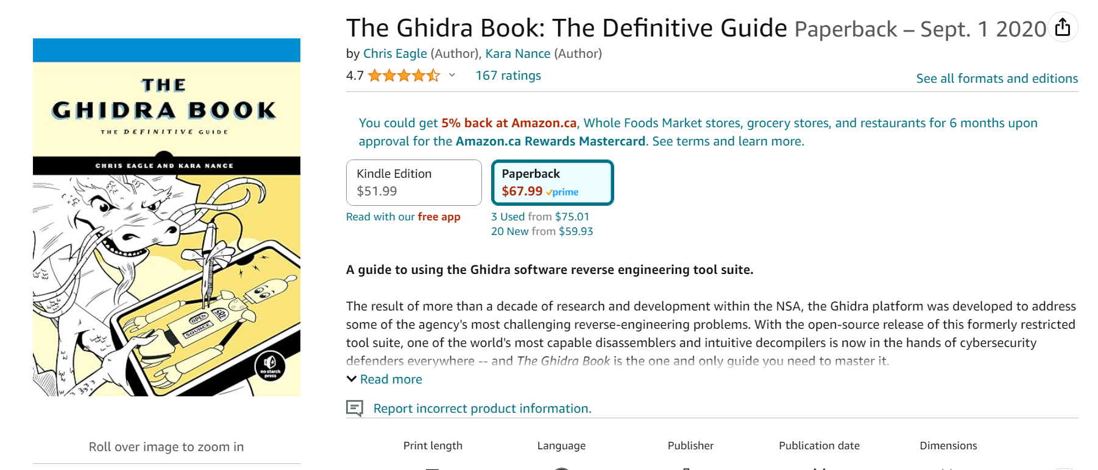
Books for Reverse Engineering (Going Deeper)

Slide 5
What we are going to cover in this section:
What is reverse engineering (this quicky lecture).
Examples of C → Assembly
Exploring Function Calls
Looking at a few example binaries
…There is a *lot* more you can do with this ☺

